Slide 1


Disability Employment Gap
Public Social Partnership
The Story So Far
16th September 2021

Slide 2
Welcome
David Cameron
Chief Executive Officer

Slide 3
Today’s Agenda
Keynote by Richard Lochhead MSP, Minister for Just Transition, Employment & Fair Work.
An Introduction to the PSP
People with Lived Experience in the PSP
Some brilliant reasons to employ disabled people - author Jane Hatton.
What the PSP is achieving
The PSP in Action – our workstreams and projects
The Future of the PSP

Slide 4
Today’s Meeting
70+ stakeholders across Scotland
14 contributors, presentations and videos (in 90 minutes!)
Please mute your mic
Our BSL Interpreter for today – Helen Dunipace 📌
We’ll pause for some questions or raise your hand if it’s urgent
Use the chat function to share your comments
Leave feedback and we will respond

Slide 5
Richard Lochhead MSP
Minister for Just Transition, Employment and Fair Work

Slide 6
Introduction to the PSP
Why did you decide to join the PSP?

Slide 7
People with Lived Experience
in the PSP

Slide 8
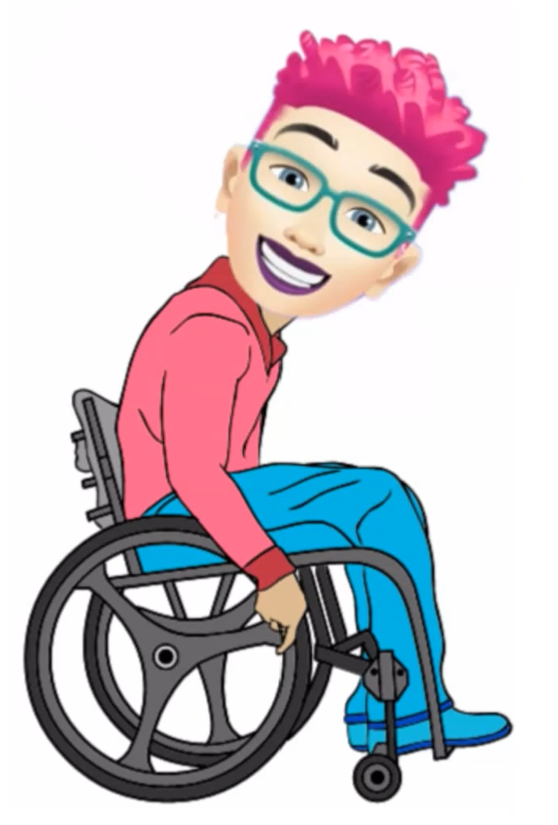
Dr Danielle Farrell
Your Options Understood
Y.O.U was established in 2015.
Up until this point, I had been struggling to gain employment
Someone who I worked quite closely with suggested I consider setting up my own business
I hadn’t previously considered this, but it planted a seed… I initially approached Business Gateway who put me in touch with the Prince’s Trust and Y.O.U was established

Slide 9
Dr Danielle Farrell
Your Options Understood
Y.O.Us Work to date
During lockdown I broadened what Y.O.U could offer and rebranded my business
Y.O.U’s services include advocacy, training and education, consultancy, self-directed support advice and person-centred planning support
Y.O.U also works in partnership with various organisations such as In Control Scotland, Independent Living Fund and most recently the Scottish Union of Supported Employment.

Slide 10
Dr Danielle Farrell
Your Options Understood
The main challenges I have faced in my employment journey to date
Access to Work
Transitioning from being a “trail blazer” to paid employment
Assisting employers in understanding that it is not just about interviewing or employing disabled people – it’s about looking at the bigger picture.
Breaking down the barriers between being an individual who receives support AND the Managing Director of Y.O.U who can provide support and services to organisations seeking to be fully inclusive.

Slide 11

Margaret Barton
The challenges of getting into work
Background
Barriers
Lessons
Life Changing Event
New Information

Slide 12

Jane Hatton
Brilliant reasons to employ disabled people

Slide 13
Apt Disability Employment Gap PSP
What the PSP is Achieving
Thursday 16th September 2021
David Stewart
PSP Project Manager
David.Stewart@susescotland.scot
07305 064 282

Slide 14


Apt - The Disability Employment Gap PSP
The Challenge
DISABILITY EMPLOYMENT GAP
DIFFERENCE OF
32.6pp
49% of disabled people in employment
81.6% of non-disabled people in employment
Source: Scotland’s Labour Market: People, Places & Regions – Annual Population Survey 2019

Slide 15

46 Apt PSP Partners

Slide 16





What is the Apt PSP Doing – Partners?
46
Partner organisations
36
3.8m
People with lived experience consulted
Online audience
96
People collaborating across Scotland
Hours volunteered

Slide 17





What is the Apt PSP Doing – Delivery?
230
81%
174
Employers engaged
Online sessions delivered
81%
of funding allocated to frontline delivery
6
1120
Innovative projects underway
Employees trained

Slide 18


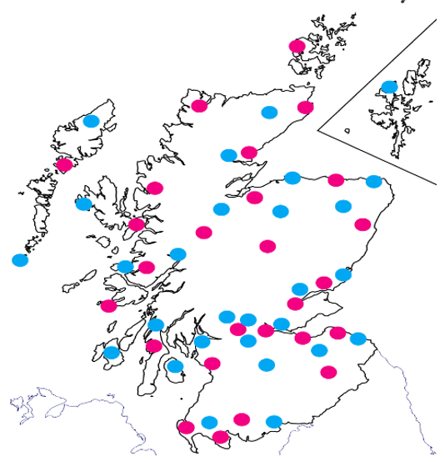


















What Employers are Involved & Where?

Slide 19
What are Employers Saying?
95% want to receive more support from the Apt PSP
95% will implement the learning into their workplace
95% are more confident about subjects associated
with employing disabled people
We’re looking for more great employers to work with.
To enhance your organisation, contact David.Stewart@susescotland.scot

Slide 20
The PSP brand and website

Slide 21
PSP Partners
What has been your experience of the PSP?

Slide 22
The PSP in Action

Slide 23
Public Sector Workstream
Nicola Mulholland
Committed to social justice
Anchor in community for supporting people with learning disabilities/difficulties in to employment
Focus on reducing the disability employment gap
Major employer in the area
Below national average for employing people with a disability

Slide 24
Public Sector Workstream
Nicola Mulholland
Need to live it as an employer, as well as an educator
Root and branch review of HR and employee journey
Recruitment and onboarding
In employment support
Opportunities for discussion, exploring support and learning
Living the vision of the college by unleashing potential

Slide 25

Attract & Recruit Workstream
John Brown
Background
Design Team
Employers
Research
Model v Framework

Slide 26

Helen Martin
Supporting Individuals to Overcome Difficulties with Digital Recruitment
Digital recruitment has helped make applying for jobs more accessible. However, it has also created some barriers for people with disabilities and health conditions.
Some of the most common barriers encountered
Participant feedback
Solutions

Slide 27

Retention Workstream
Emma Soanes
      Initial focus on barriers to successful retention
      Data v Stories
      Lived Experience of the workplace
        Exclusion
        Lack of career development
        Lack of support
        Awkwardness with colleagues and managers
        Lack of knowledge and understanding at all levels
      Positive stories too! 😊
      But no consistency 😞

Slide 28
Emma Soanes
Two key elements to successful retention
The practical stuff
  Information & support employers
  Making it accessible (one stop shop)
  Practical tools – wherever you are on the journey
the Retention Pathway Project
Cultural (and lasting) change
  A need for a shift in thinking
  A genuine response to the fear
  Unravelling the ‘what if I say/do the wrong thing’?
  Awkwardness leading to avoidance
  Tackling the elephant in the room!
the Apt Social Media Campaign

Slide 29
Emma Soanes
We want to boldly identify some of the fears and myths that are prevalent still, and challenge this without judgement but with offers of support.
Content will be targeted across all sectors
Initial focus on HR, recruitment and management roles, using a variety of platforms
Bold, simple imagery and messaging
Our aim? To start conversations and get people asking questions.
With the right tone of (warmth and without judgement) we might just make a difference.
So, if in doubt, Ask Apt!

Slide 30




Emma Soanes
Social Media Campaign

Slide 31

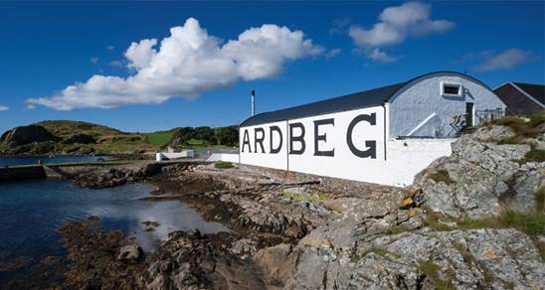
Lindsey Danks

Slide 32

Kirin Saeed
Introduction and background.
My work with the PSP to date
Training
recruitment of participants to work streams
the importance of “lived experience” trainers and participants.
Always learning new methods of work
Simplify work
Positive and creative ways forward

Slide 33
Liam Simpson
Why its so important that people with autism/disabilities deserve a job.
Autism/disabilities – Numbers are so high and employers need to be ready
Employing people with Autism/disabilities has so many business benefits

Slide 34

Sumar Williams
Structure of sessions
  Thoughts on co-delivering the sessions
  Reduce stigma and misunderstandings
  Importance of Lived Experience
  Discussion opportunities for employers
How did the sessions go?
  Myself
  Participants
What did we hope to achieve?
  Greater understanding
  Seeing strengths as well as struggles
  Challenge stereotypes and negative tropes
Reduce worries/concerns of employers

Slide 35
Transitions
Steven Laidlaw
Shetland Recreational Trust
Getting disabled people working in mainstream organisation
Providing 8 base operations for opportunities
Removing barriers for work
Developing a casual workforce
Providing work experience opportunities
We are a community operation that needs to embrace the whole community
Providing one to one mentoring
Working with partners to find a way to help

Slide 36
Future Vision
What would a good outcome for the PSP look like?

Slide 37

The Centre of Excellence
To bridge the DEG - 10,000s of disabled people moving into work
We need Supported Employment services.
Fair Start Scotland, MAs, Employability Fund etc to be fully inclusive
But….

Slide 38

The Centre of Excellence
…… this won’t bridge the gap – unless employers change
They want to do the right thing – but they need our help
Learning, capacity building and change programmes.
We need a Centre of Excellence for Scotland’s employers.

Slide 39
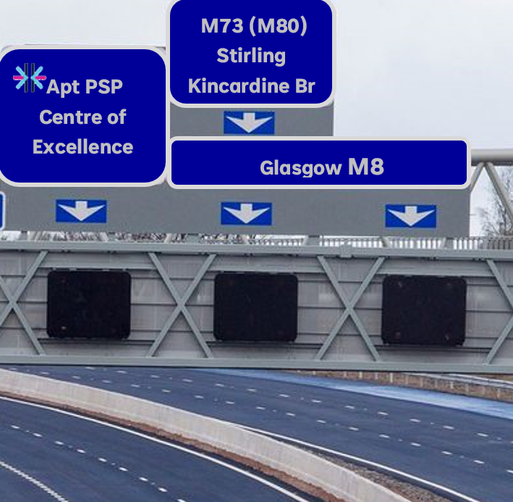
The Centre of Excellence
A self-sustaining enterprise
Small, medium and large employers
Urban, rural and island communities
Lasting relationships that promote continuous improvement
Accreditation and recognition of their achievements

Slide 40

The Centre of Excellence

Slide 41

Coming Soon!

